Slide 1
Tutorial AndroidStudio

Slide 2
Requirements
AndroidStudio
Configure an emulator of a Android device

Slide 3
Tutorial
We créate a new Project
Put any name, example: Clock Example
Select the target Android OS
Then Next
You can put an image file for the icon
Next
Select Black Activity
Then Finish

Slide 4

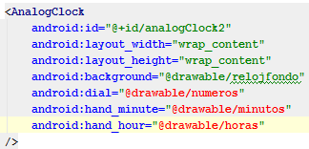
Tutorial
It will appear the fragment_main.xml
In there you must put the following code to generate an analog clock:
You can modify the background, the numbers and the needles

Slide 5
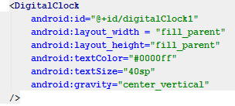
You can also make a digital clock. You need to put the following code on the fragment_main.xml
You can change the color of the Font and also the Font size, and the position.

Slide 6
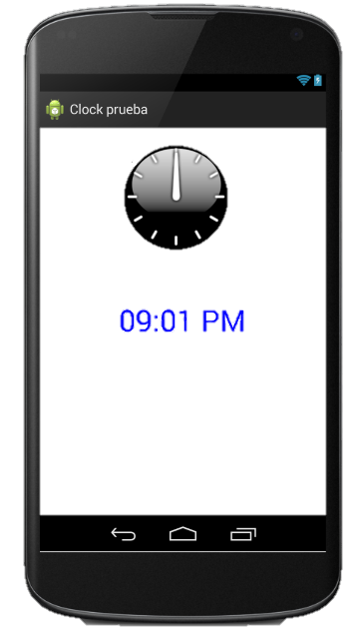
At the end you run it on the emulator.

